Slide 1
FILE MANAGEMENT:–
1 file mgmt 2 directory mgmt 3 permissions 4 user mgmt 5 service mgmt 6 package mgmt 7 storage mgmt. 8 process mgmt. 9 network mgmt
10 backup tooLs
•File management-
Create ,modify,delete,view,copy,move,hide,unhide
•Directory mgmt-Create,change,direct,list,delete,accessing directory
•permission mgmt- Read,write,execuACLs
•User mgmt:-Create,modify,delete,giving access to a group,sudo user.
•Service mgmt- Start,stop,enable,disable,restart.
•package mgmt- Install,query/info,upgrauninsta
•storage mgmt-list the size,createpartion,edit,dlt.
•process mgmt-list,chnge the priority of the process.
•Network management –viewing the ip address changing the ip address restart the network.
•Backup tools- archives and compression tools.
File mgmt-crea a file using touch(use for creating blank file,upgratthe times stamps of a file or directory last time the file update ,)
(syntax= touch filename.txt)
When file doesn’t exist ,= touch cmd reate a file.
When file exists ,touch and upgrade the timestamp of the file
-cat
-gedit
-nano
-vi/vim

Slide 2
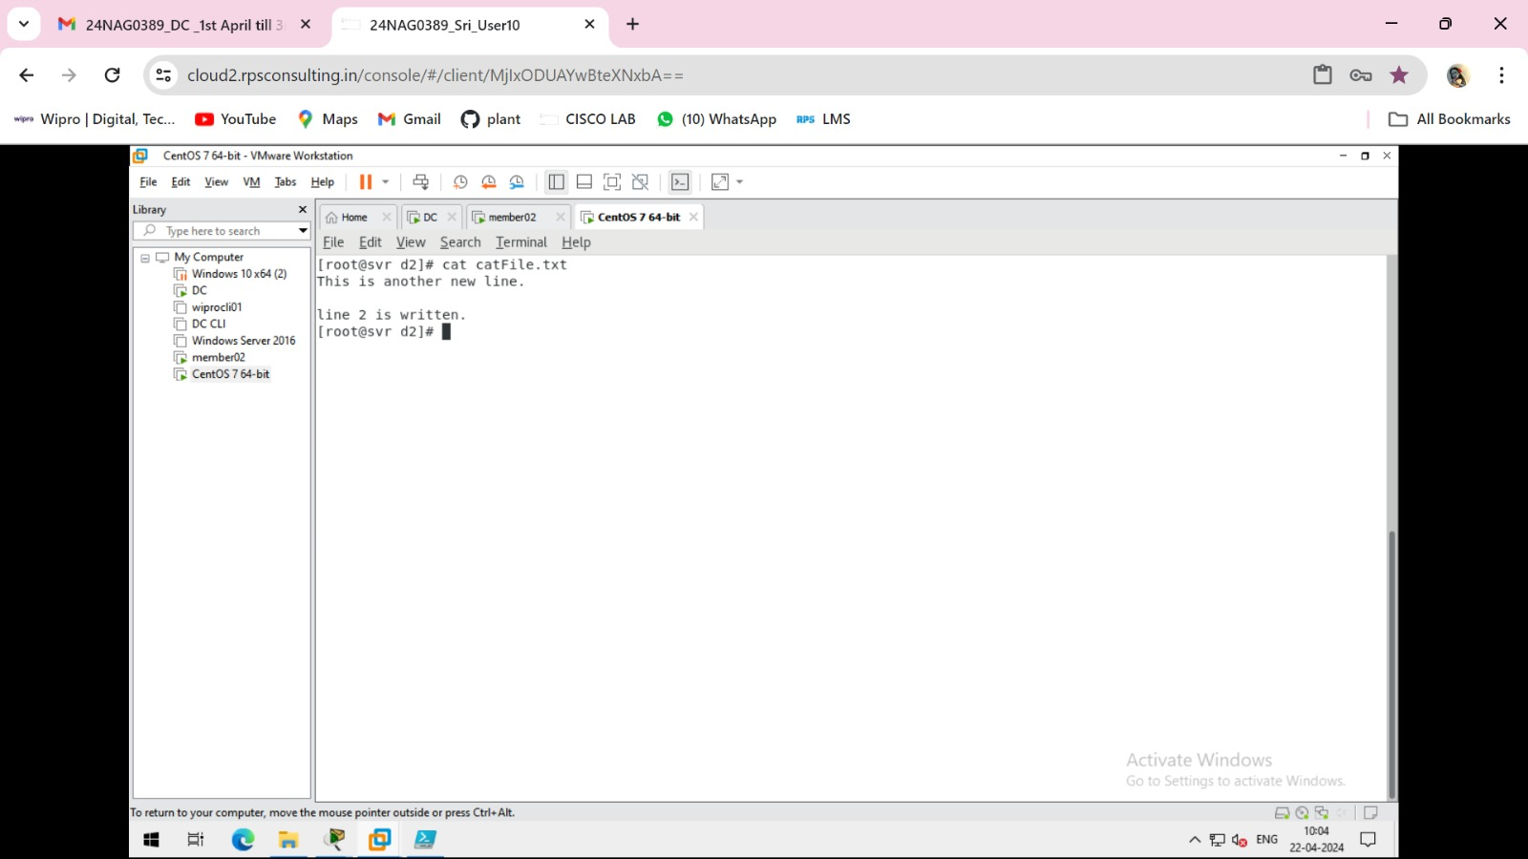
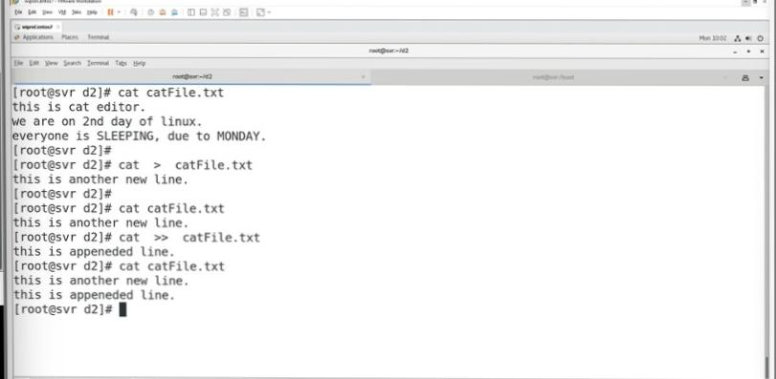
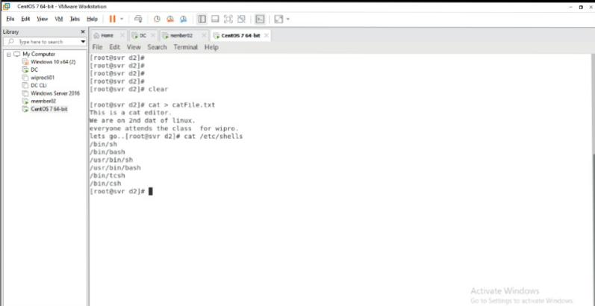
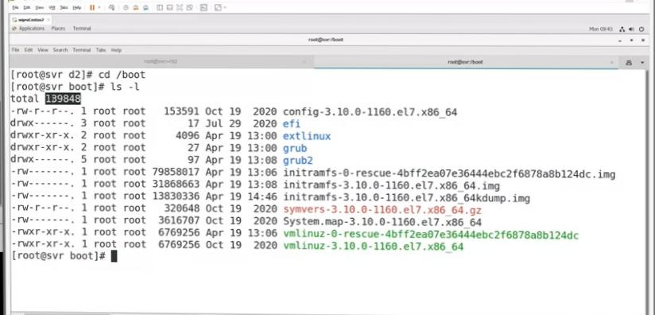
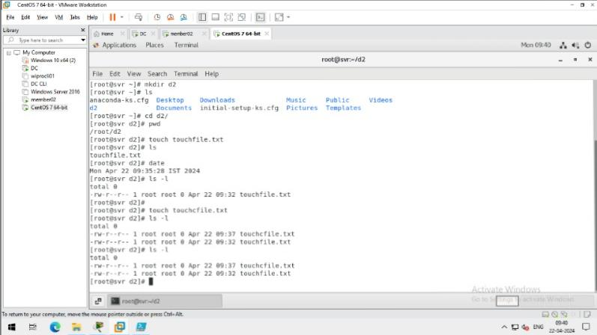
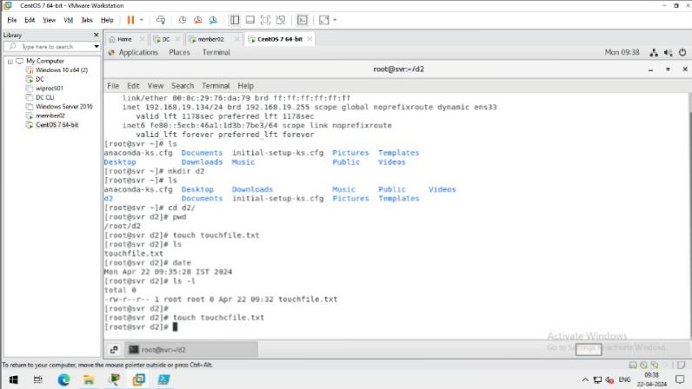
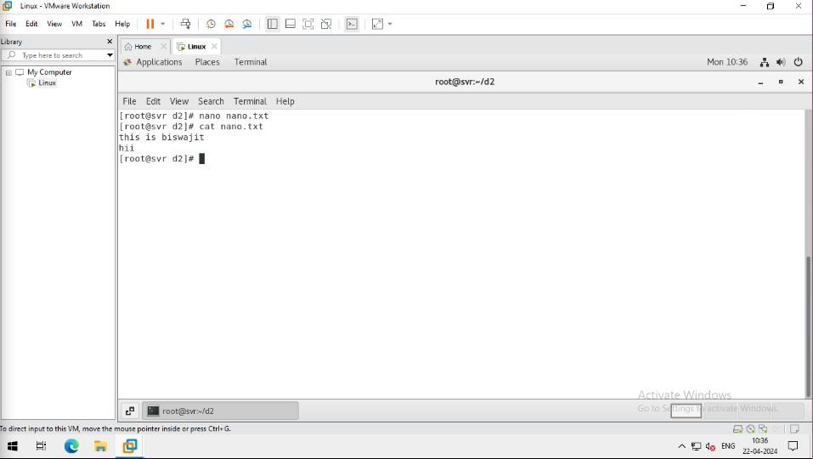
Creating a file using cat command:-
2.
1.
Using cat command view the shell s on linux
2.
1.
Create a file using touch cmd:-
2.
1.
Create a file using nano cmd:-
nanofile edit-its a editing file and modelesseditor To save nano file editor press cnt+x type y for yess and hit enter Then type cat nanofile.txt for show the file data

Slide 3
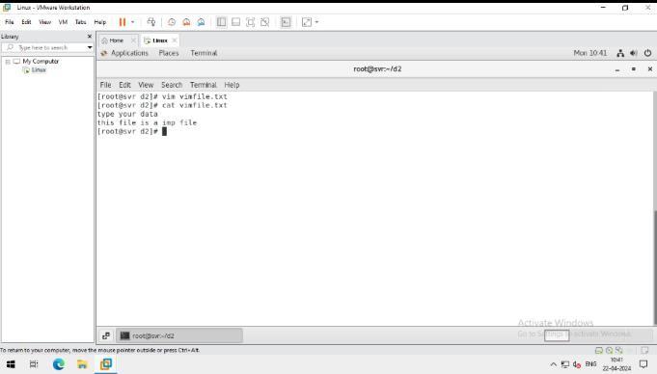
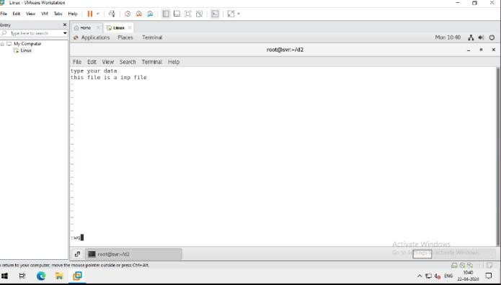
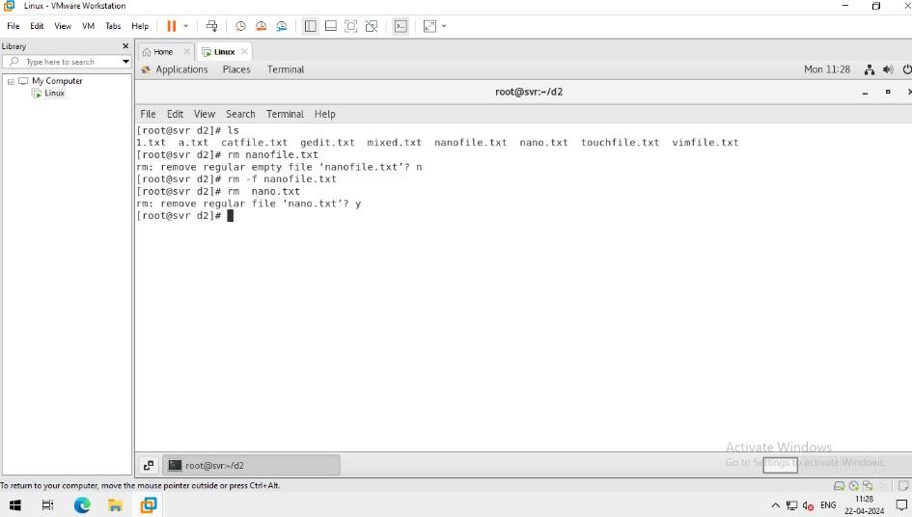
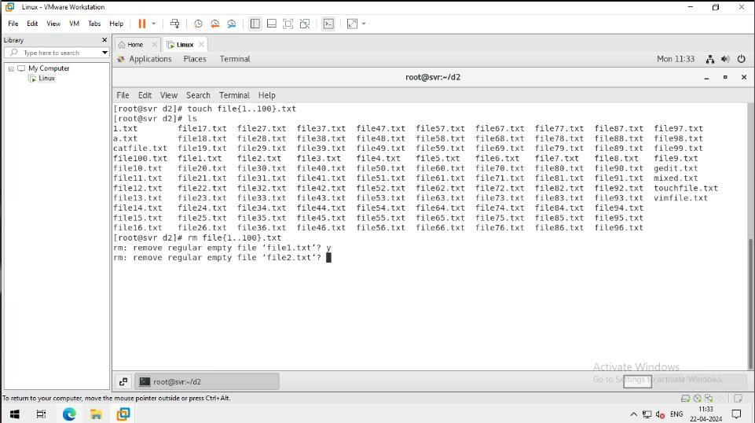
Create a file using vim Command
Use of rm command
Task-1 Create 100 files using a single command

Slide 4
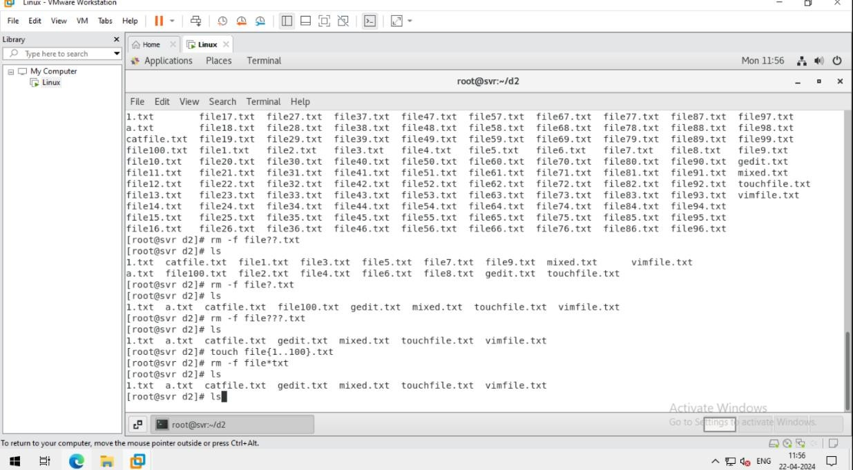
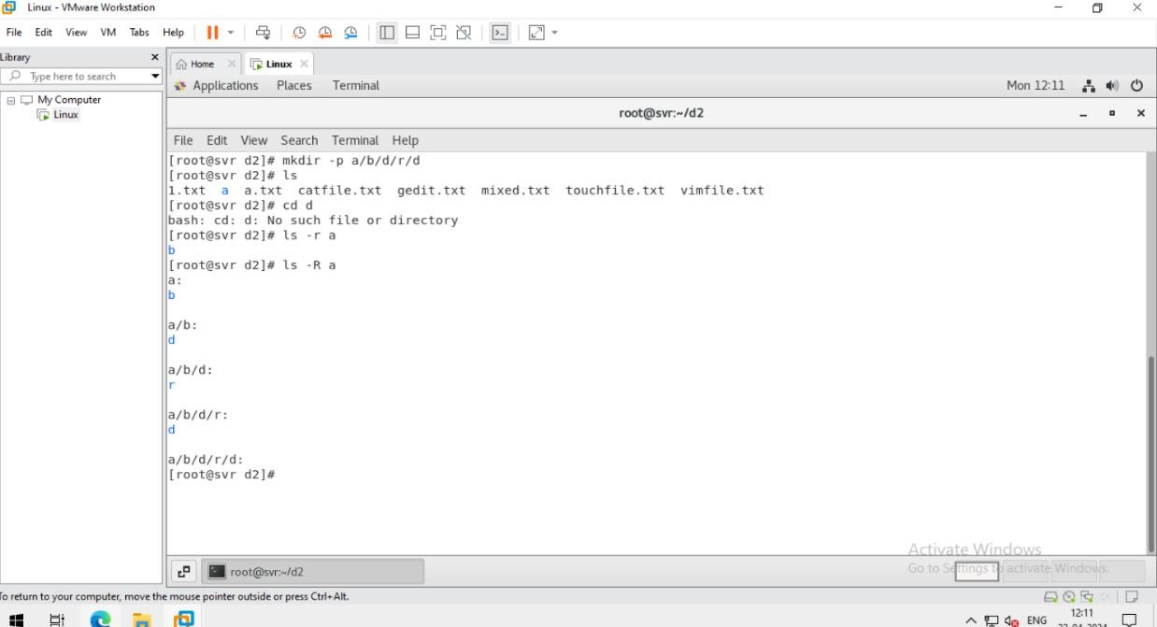
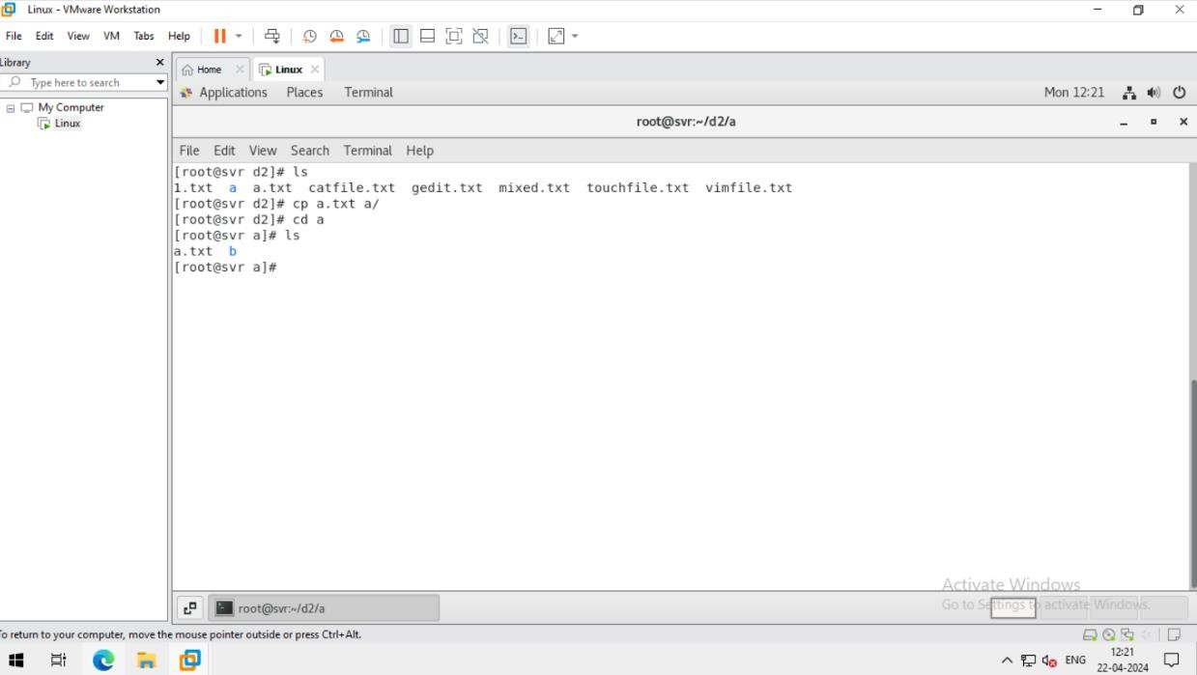
Use of “?” and “*”
Task -2 Create a directory within a directory using a single command
Use of cp command

Slide 5
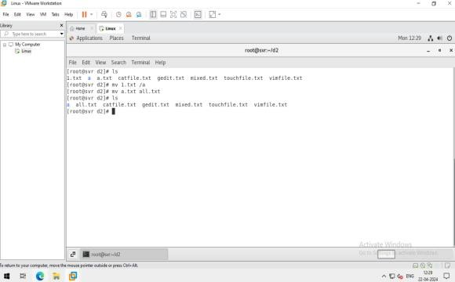
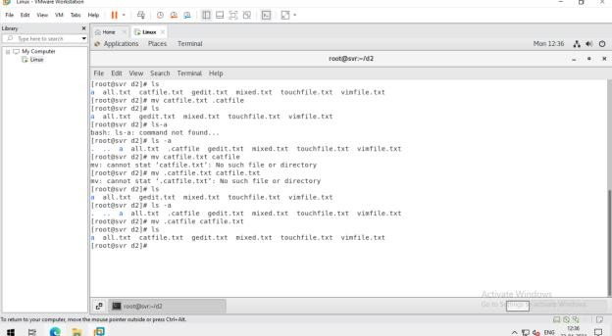
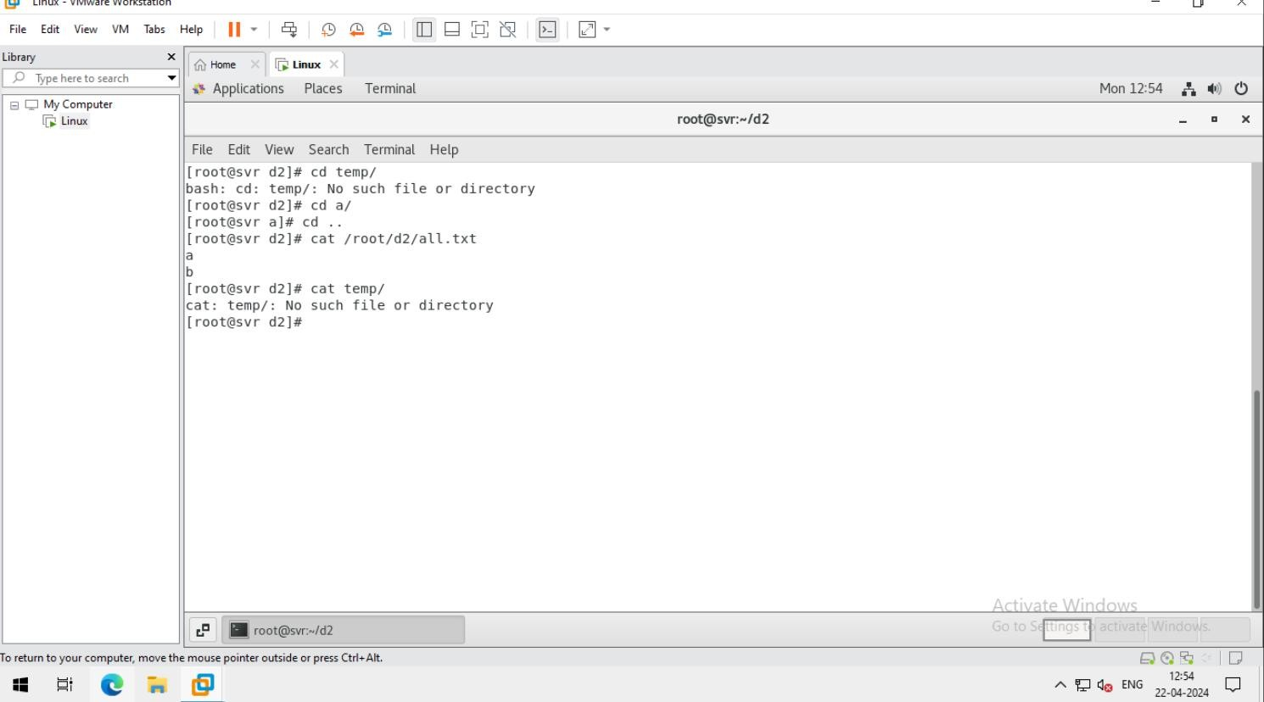
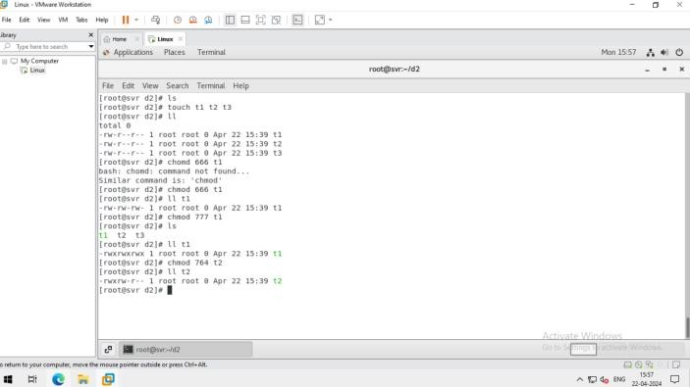
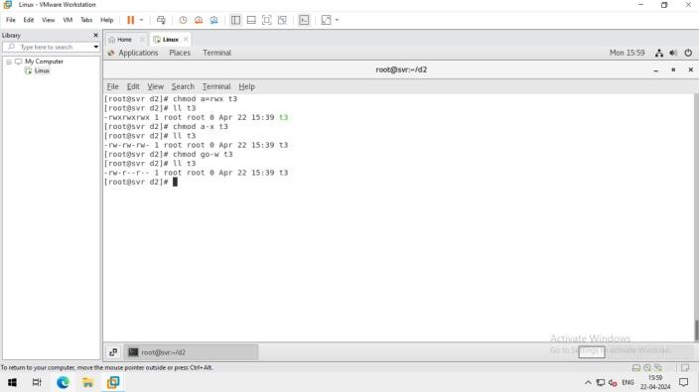
use of mv command
Absolute path VS relative path
Play with permissions

Slide 6
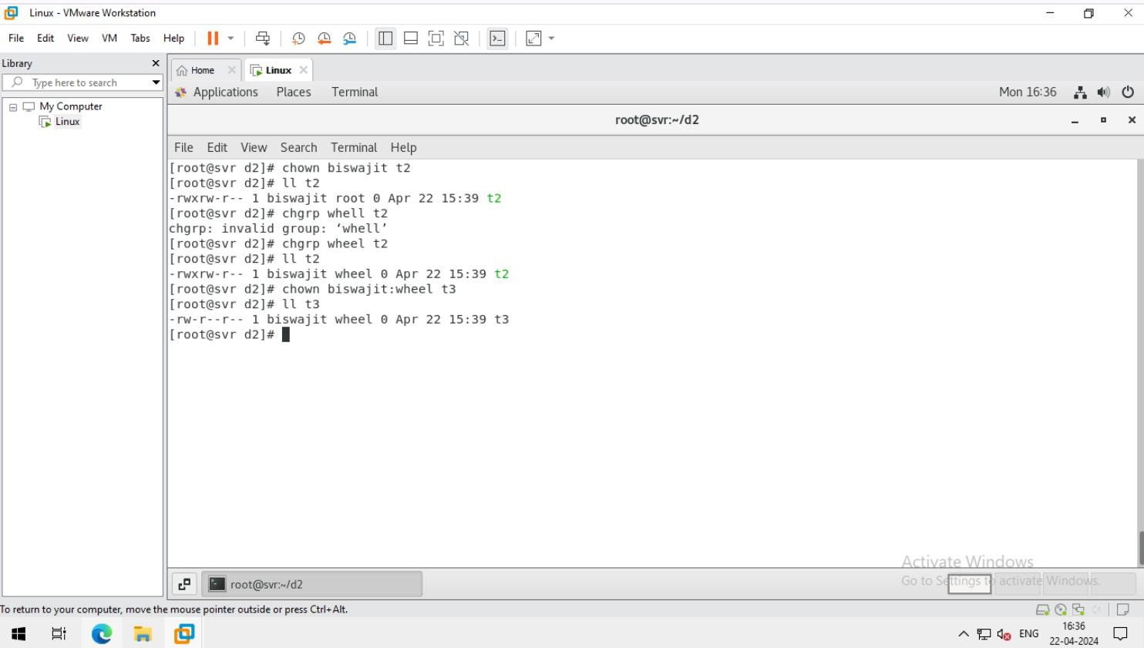
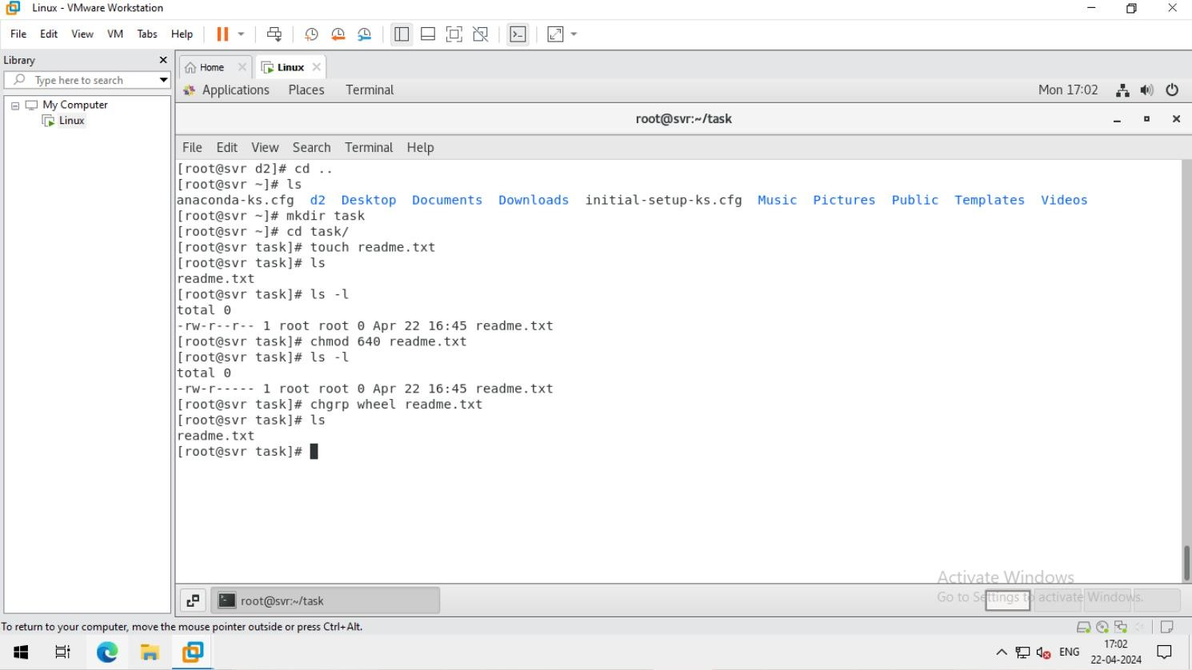
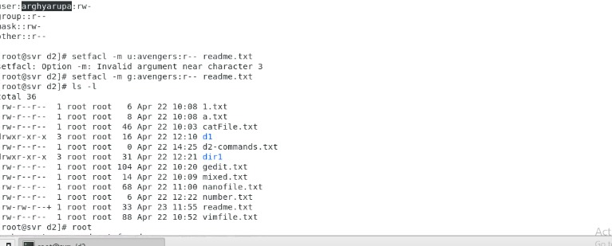
Task-3 create a permission u=r/w/x, g=r/e, other=r and attach wheel file.
Task-4 create a test file set permission as u=rw,g=r,o=no and attach wheel group

